Slide 1
Analysis of trimethylamine and trimethylamine N-oxide by headspace GC-MS

Slide 2
Trimethylaminuria
Fish odour syndrome
Inability to metabolise odorous compound trimethylamine (TMA)
TMA has characteristic odour of rotten fish
Excretion in body fluids, especially sweat, leads to body odour
Social isolation, depression, suicidal ideation

Slide 3
FMO3 pathway
Dietary precursors
TMA is formed by the action of gut bacteria on dietary precursors
TMA is metabolised in the liver by the action of flavin-containing mono-oxygenase 3 (FMO3)
Non odourous metabolite trimethylamine-N-oxide (TMANO) is excreted in the urine
Gut bacteria
TMA
FMO3
TMANO
Excretion

Slide 4
FMO3 pathway
Dietary precursors
TMA is formed by the action of gut bacteria on dietary precursors
TMA is metabolised in the liver by the action of flavin-containing mono-oxygenase 3 (FMO3)
Non odourous metabolite trimethylamine-N-oxide (TMANO) is excreted in the urine
Variants in FMO3 gene lead to primary trimethylaminuria (TMAU1)
Gut bacteria
Sweat
Breath
Body fluids
TMA
FMO3
TMANO
Excretion

Slide 5
FMO3 pathway
Dietary precursors
TMA is formed by the action of gut bacteria on dietary precursors
TMA is metabolised in the liver by the action of flavin-containing mono-oxygenase 3 (FMO3)
Non odourous metabolite trimethylamine-N-oxide (TMANO) is excreted in the urine
Variants in FMO3 gene lead to primary trimethylaminuria (TMAU1)
Dietary overload / bacterial overgrowth leads to secondary trimethylaminuria (TMAU2)
Gut bacteria
Sweat
Breath
Body fluids
TMA
FMO3
TMANO
Excretion

Slide 6
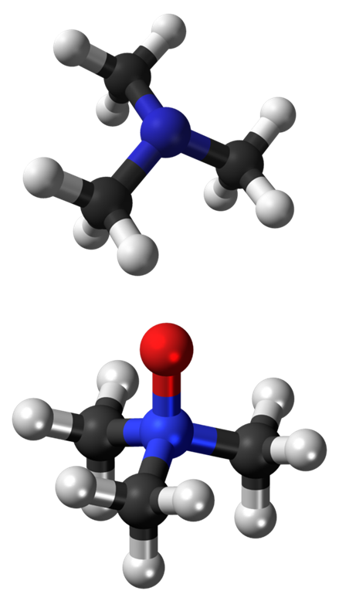
TMA and TMANO
Analysis in urine can be used to aid diagnosis and differentiation of TMAU1 and TMAU2
TMA: small, volatile molecule
TMANO less volatile, remains in solution
Various techniques
¹H-NMR
LC-MSMS
HS-GCMS
Sheffield receive approx 300 requests per year
~80% ‘normal’

Slide 7
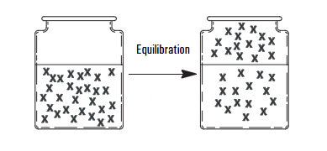
Headspace GCMS
Method of analysing volatile compounds
‘Headspace’ refers to space in vial above liquid sample
Sample is heated, partitioning volatile analyte between liquid and gaseous phase
Probe samples from headspace and injects onto column
Static / dynamic sampling
SPME
Twin Line system
Switch between headspace and liquid sampling
Efficient use of analyser capacity
Notes:
Method development, consider equilibration, time and temperature.

Slide 8
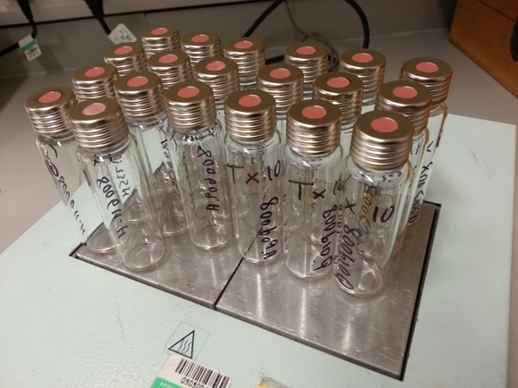
Assay workup
Urine sample is collected, ideally post ‘choline load’
Sample is acidified to stabilise TMA as the soluble HCl salt and prevent pre-analytical loss
TMA is liberated from solution by addition of concentrated KOH
TMANO is reduced to TMA by the action of TiCl₃ followed by alkalinisation as above
TMANO samples are pre-diluted tenfold
Headspace vials are loaded onto analyser
Equilibration is at 50C for 15mins, with shaking
Static headspace sampling
1ml headspace vapour is loaded onto column

Slide 9
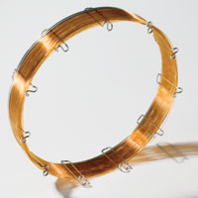
Analysis - GC
Separation is by highly polar PEG ‘wax’ stationary phase, 30m
40C isothermal GC program followed by temperature ramp to regenerate column

Slide 10
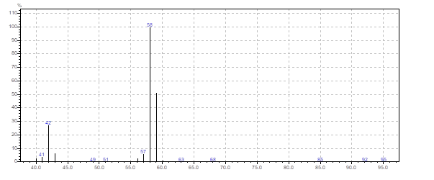
Analysis - MS
Electron impact ionisation produces spectrum with characteristic [M-H]⁺ fragment
Analyse in SIM mode for best sensitivity

Slide 11
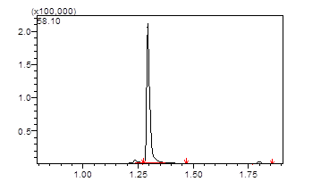
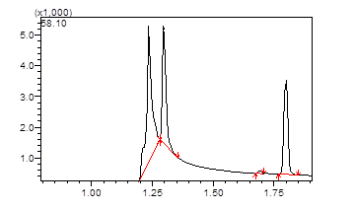
Chromatography
Data collected over four minute period
TMA elutes at approx 1.3min
Coelution with air peak
Low concentrations require careful adjustment of integration parameters
Potential interference from air peak and from acetone (m/z 58)
Air
TMA
Acetone

Slide 12
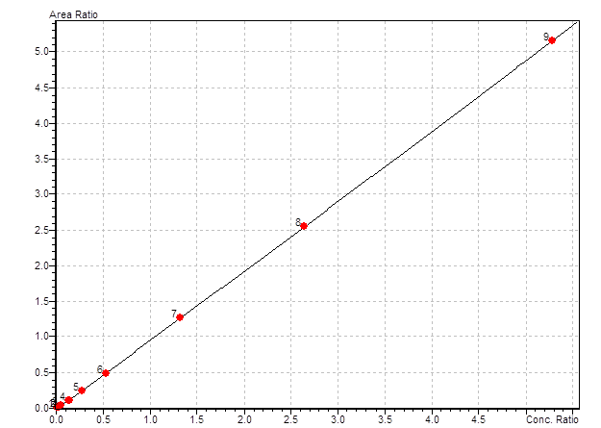
Quantitation
Deuterated internal standard (D9-TMA)
Quantitation by area ratio of TMA to D9-TMA
Nine point calibration curve
LOQ 2.5µmol/L
Linearity 1000µmol/L (TMANO 10,000)
High concentrations repeated on dilution

Slide 13
Results
Reference ranges
Total and free TMA
Reported as ratio to creatinine
Subtract free from total TMA to give TMANO
Ratio of TMANO to total TMA gives % N-oxidation
Marker of enzyme activity
From literature
Maschke et al, Clinica Chimica Acta 263 (1997) 139-146
TMA <7.7 µmol/mmol creat
% N-oxidation >94%
Requires careful interpretation
Total TMA >14 µmol/mmol crt
Low total TMA can indicate insufficient dietary intake of TMA precursors to allow correct interpretation

Slide 14
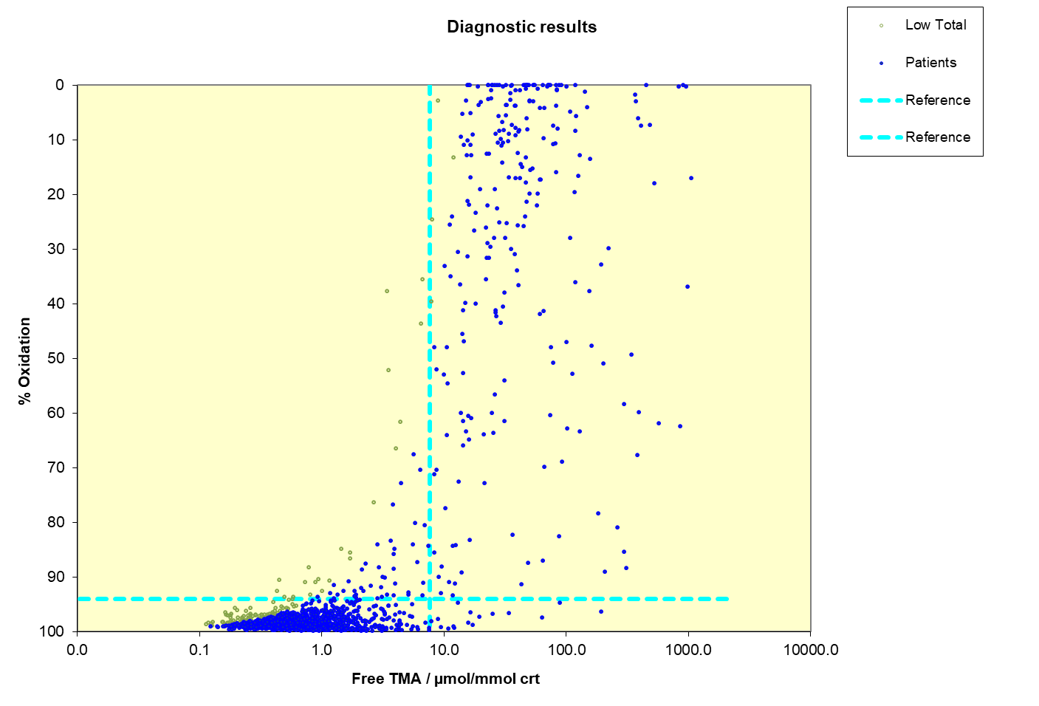
Interpretation
Quantitative results
TMA, TMANO, % N-oxidation
Interpretative comments for non-specialist clinician
Increased TMA with reduced oxidation suggests TMAU1 / FMO3 deficiency
Increased TMAU with normal oxidation suggests TMAU2
Low total TMA suggests patient on treatment or requires choline loading
Borderline result requires repeat with choline load
Repeat samples for confirmation
Exclude UTI
Transient / intermittent forms

Slide 15
Followup
Metabolic clinician
Molecular genetics
Known variants
Dietician
Therapy
Dietary
Antibiotics
Riboflavin
Low pH soaps
Deodorants
Monitoring
Support groups

Slide 16
Quality
No commercial QC available
Spiked urine at two levels
No EQA scheme
Sample exchange program
Five laboratories worldwide
Different methods
Qualitative / diagnostic

Slide 17
Conclusion
Headspace sampling enables analysis of volatile compounds contained within an aqueous matrix
Sampling may be direct from the headspace vapour or pre-concentrated by methods such as SPME, purge and trap
Maximum recovery requires careful manipulation of incubation parameters
Analysis of volatile compounds requires specific column and analyser settings
Esoteric tests require consideration of quality issues
International networks are of importance in the study of rare diseases

