Slide 1


Developing a dried blood spot method for the detection of bile acid synthesis disorders
Genetics and Genomics Medicine Research & Teaching Dept.
UCL Great Ormond Street Institute of Child Health (ICH)
Rohit Hirachan
Dr. Youssef Khalil
Prof. Philippa Mills
Prof. Peter Clayton

Slide 2
Bile acid synthesis disorders (BASDs)
At least 9 BASDs have been identified, including:
    3β-hydroxy-Δ5-C27-steroid dehydrogenase deficiency
    Δ4-3-oxosteroid-5β-reductase deficiency
    Cerebrotendinous xanthomatosis (CTX).
Arise due to a genetic defect in one of the enzymes involved in the synthesis of the primary bile acids (BAs):
    Cholic acid (CA)
    Chenodeoxycholic acid (CDCA).
Symptoms can include:
    Cholestasis (reduced bile flow)
    Inability to absorb lipids
    Steatorrhea (fat excreted in stools)
    Deficiency of fat-soluble vitamins (A, D, E, and K)
    Liver damage
    Neurological symptoms.
    Oral BA replacement therapy is available for affected patients.

Slide 3
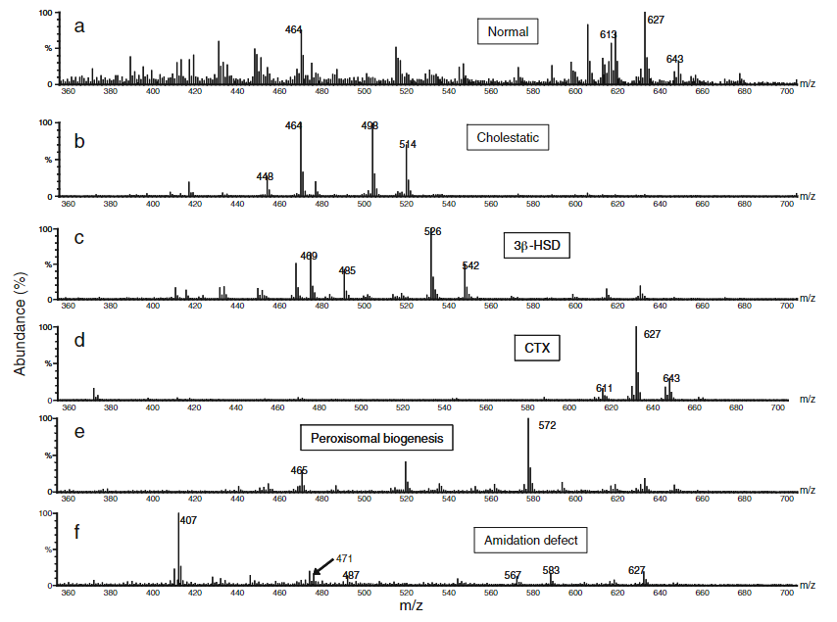
Detecting BASDs
Currently use tandem mass spectrometry (MS/MS) to detect BASDs using urine.
Qualitative assay – look for presence of primary BAs and “unusual” BA intermediates.
Clayton, 2011.

Slide 4
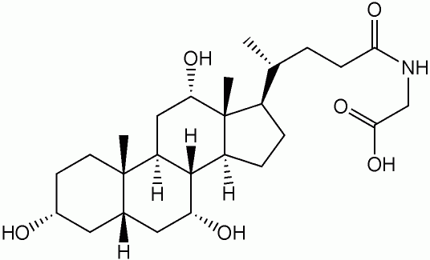
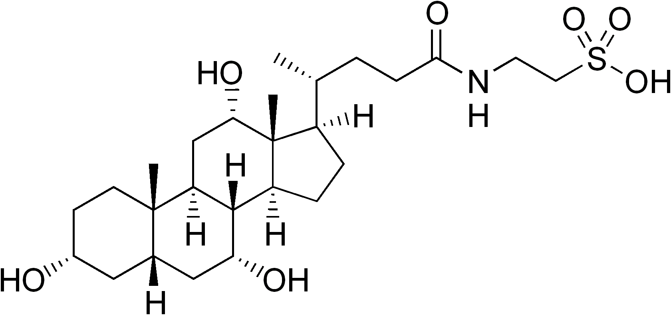
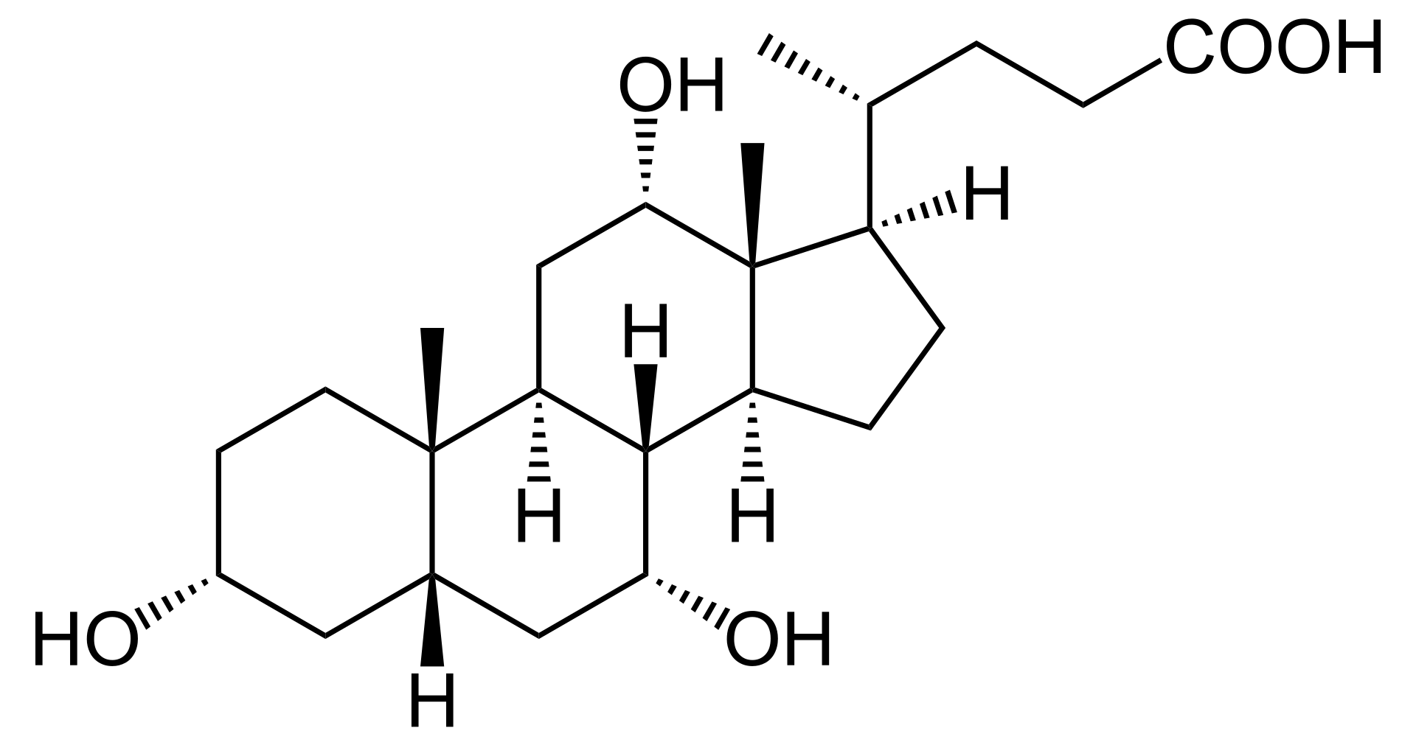
BAs can either remain unconjugated, or be conjugated to a glycine, taurine, glucuronide, or sulphate
For example:
Taurocholic acid (TCA)
Cholic acid (CA)
Glycocholic acid (GCA)

Slide 5
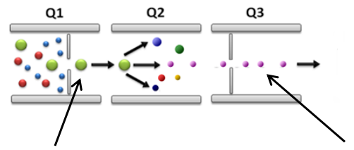
MS/MS principle
Triple quadrupole MS/MS
Glycocholic acid (GCA)
Sample is ionised
Detector
Selected product ion for GCA m/z = 74
Selected precursor ion for GCA m/z = 464
m/z = mass-to-charge ratio

Slide 6
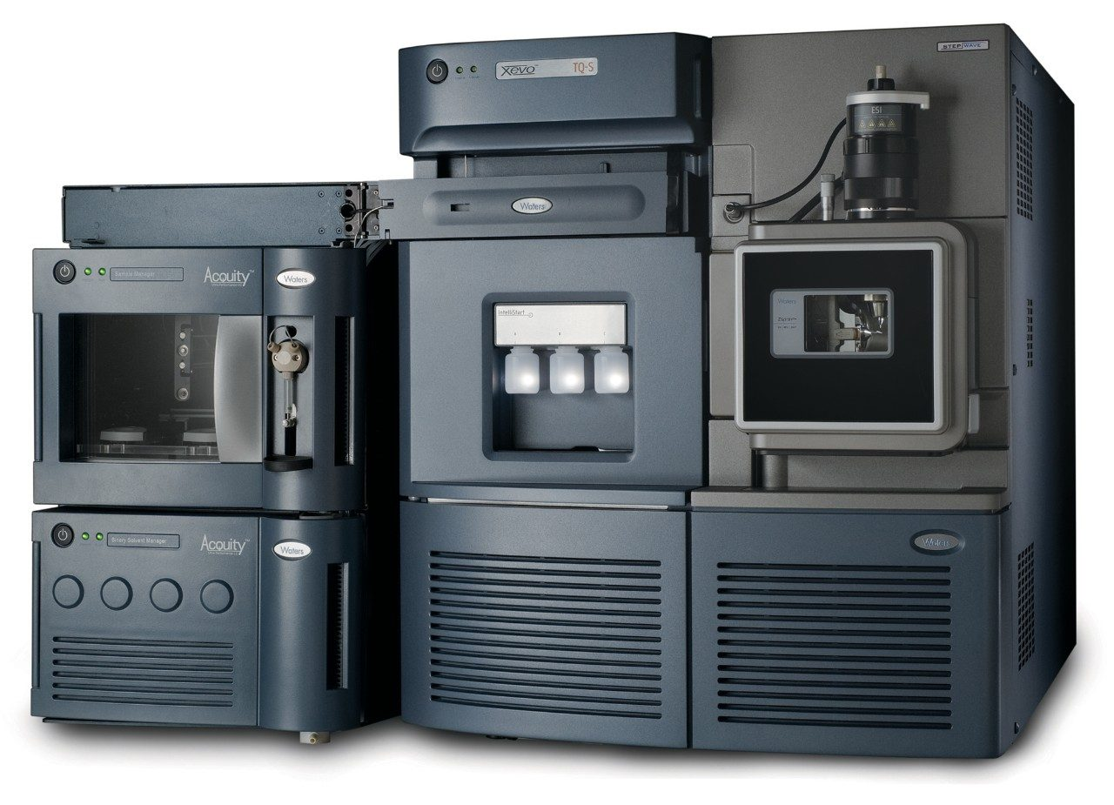
Dried blood spot (DBS) method
Developing a quantitative Ultra Performance Liquid Chromatography (UPLC) MS/MS method using DBS.
Advantages of DBS:
    Convenient to transport and store
    Potentially easier to obtain from newborns
BASDs included in the Genomics England Generation Study Newborn Screening pilot.
Waters™ ACQUITY UPLC System with Xevo TQ-S MS

Slide 7
Considerations when developing a method
Optimising extraction of bile acids from DBS
      - Sample preparation
“Tuning” mass spec to improve sensitivity
      - Correct m/z ratio
      - Cone voltages and collision energies

Slide 8
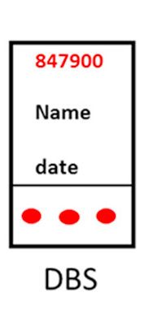
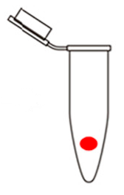
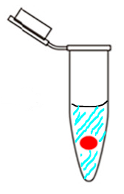
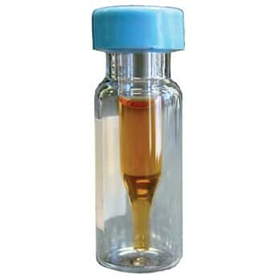
Optimising extraction of BAs from DBS
Using previous work published from Peter and Philippa’s lab (Mazzacuva et al., 2016).
Ready for analysis
Add 300 μL of methanol containing internal standard(s)
Sonicate for 15 minutes and then transfer solution to a glass vial
Punch 6 mm disc
Adapted from Müller et al., 2017

Slide 9
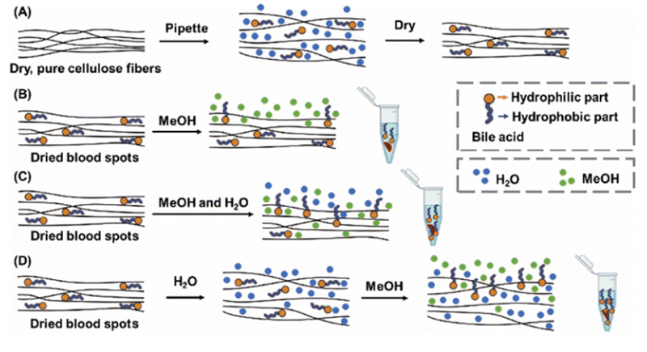
Optimising extraction of BAs from DBS
Addition of water improves the extraction of BAs from the filter paper (Ma et al., 2023).
Ma et al., 2023

Slide 10
Optimising extraction of BAs from DBS
We looked at using 90% and 80% methanol solutions and compared results for the primary BAs.
Ready for analysis
Add 270 μL of methanol containing internal standard(s) followed by 30 μL of water (90%)
Or add 240 μL of methanol containing internal standard(s) followed by 60 μL of water (80%)
Sonicate for 15 minutes and then transfer solution to a glass vial
Punch 6 mm disc
Adapted from Müller et al., 2017

Slide 11
Peak Area of CA after extraction with different methanol solutions
DBS used from one unaffected individual with the average result taken.
Addition of water gives larger peak area than 100% methanol.
On average, 80% methanol solution gives greatest area.

Slide 12
Tuning BAs to improve sensitivity
Tuning ensures that the correct m/z ratio is being detected, using optimum cone voltages and collision energies.
What happens when you don’t use the most appropriate m/z ratio?

Slide 13
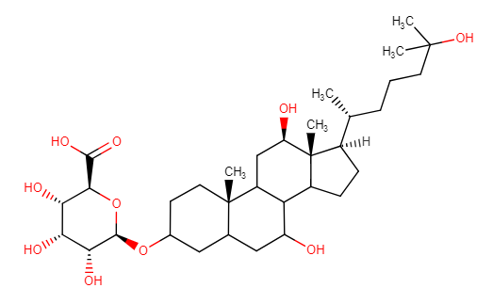
Tuning 5β-cholestane tetrol glucuronide
5β-cholestane tetrol glucuronide (tetrol glucuronide) is elevated in Cerebrotendinous xanthomatosis (CTX).
At least 3 isomers – all are increased in CTX.
Currently, this compound is not commercially available!
We have used plasma from a CTX-positive patient to manually “tune” the mass spec.
5β-cholestane-3α,7α,12α,25-tetrol-3α-glucuronide (HMDB0010355)

Slide 14
Tuning 5β-cholestane tetrol glucuronide
Selected product ion for tetrol glucuronide m/z = 85
Selected precursor ion for tetrol glucuronide m/z = 611

Slide 15
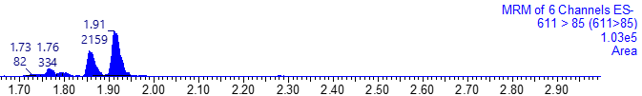
Tuning 5β-cholestane tetrol glucuronide
Observed 3 peaks for the 3 isomers.
Response much lower than expected!

Slide 16
Tuning 5β-cholestane tetrol glucuronide
Selected product ion for tetrol glucuronide m/z = 85
Selected precursor ion for tetrol glucuronide m/z = 611.39

Slide 17
Tuning 5β-cholestane tetrol glucuronide
Rounding the m/z ratio to the nearest whole number could be affecting your results!
Precursor ion m/z = 611
Precursor ion m/z = 611.39

Slide 18
Tuning mass spectrometer to improve sensitivity
Tuning ensures that the correct m/z ratio is being detected, using optimum cone and collision voltages.
Cone voltage – used to accelerate ions towards Q1.
Collision energy – used to accelerate ions in Q2 (the collision cell) causing them to collide and fragment.
If either one, or both, are too low or too high, this can cause a decrease in peak areas (low sensitivity).

Slide 19
Tuning 5β-cholestane tetrol glucuronide
Cone voltages between 50V and 80V only has a mild effect.
Changing collision energy from 30V to 50V increases area of all 3 isomers more than 10-fold.

Slide 20
Summary
We found that using 80% methanol solution was best for extracting BAs from DBS compared to 100% methanol or 90% methanol solution.
Rounding a compound’s m/z ratio to the nearest whole number can greatly reduce the sensitivity of the instrument.
Cone voltage and collision energy can also have a dramatic impact on sensitivity.

Slide 21
Acknowledgements
Thanks to Theravia (previously called Laboratoires CTRS) for funding this project.
Thanks to Alistair Horman and Helen Aitkenhead for their support in getting this project started.
Thanks to Helen Prunty for her continued support and input.

Slide 22
References
Clayton, P.T. (2011). Disorders of bile acid synthesis. J Inherit Metab Dis., 34(3), pp.593–604. doi:https://doi.org/10.1007/s10545-010-9259-3.
hmdb.ca. (n.d.). Human Metabolome Database: Showing metabocard for Cholestane-3,7,12,25-tetrol-3-glucuronide (HMDB0010355). [online] Available at: https://hmdb.ca/metabolites/HMDB0010355 [Accessed 12 Jan. 2024].
Ma, Z., Sheng, N. and Zhang, J. (2023). A feasible protocol to profile bile acids in rat dried blood spot using UHPLC-MS/MS method combining surrogate matrix. Analyst, 148(20), pp.5190–5202. doi:https://doi.org/10.1039/d3an00900a.
Mass Spectrometer (AB/Sciex). (n.d.). Available at: https://www.uab.edu/proteomics/metabolomics/workshop/2014/Ray%202014%20MRM%20Development%20Demo.pdf.
Mazzacuva, F., Mills, P., Mills, K., Camuzeaux, S., Gissen, P., Nicoli, E., Wassif, C., te Vruchte, D., Porter, F.D., Maekawa, M., Mano, N., Iida, T., Platt, F. and Clayton, P.T. (2016). Identification of novel bile acids as biomarkers for the early diagnosis of Niemann‐Pick C disease. Febs Letters, [online] 590(11), pp.1651–1662. doi:https://doi.org/10.1002/1873-3468.12196.
Müller, M.J., Stokes, C.S. and Volmer, D.A. (2017). Quantification of the 3α and 3β epimers of 25-hydroxyvitamin D3 in dried blood spots by LC-MS/MS using artificial whole blood calibration and chemical derivatization. Talanta, 165, pp.398–404. doi:https://doi.org/10.1016/j.talanta.2016.12.081.
Wikipedia. (2023). Cholic acid. [online] Available at: https://en.wikipedia.org/wiki/Cholic_acid [Accessed 19 Jan. 2024].
Wikipedia. (2023b). Glycocholic acid. [online] Available at: https://en.wikipedia.org/wiki/Glycocholic_acid [Accessed 19 Jan. 2024].
Wikipedia. (2023c). Taurocholic acid. [online] Available at: https://en.wikipedia.org/wiki/Taurocholic_acid [Accessed 19 Jan. 2024].

