Slide 1
Harvey’s Gang at the IBMS

Slide 2
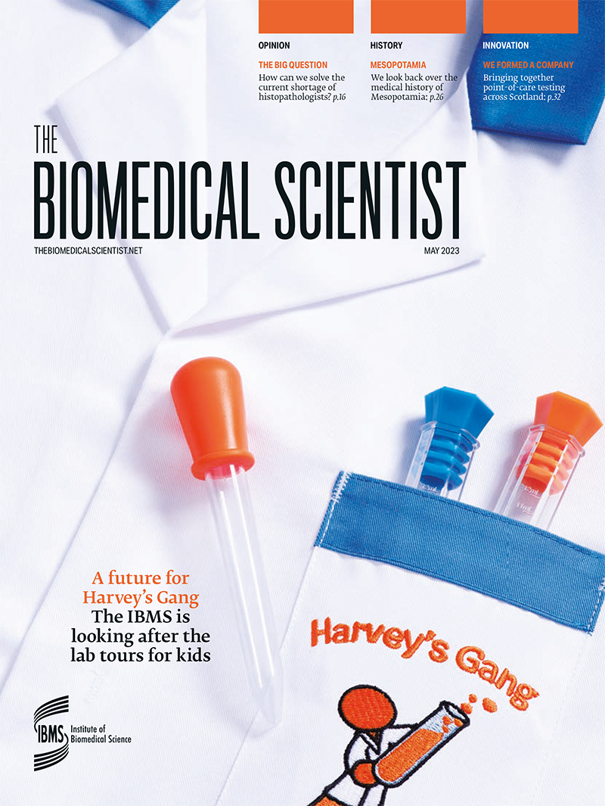
June 2023 IBMS takes over the management of Harvey’s Gang
Announced via The Biomedical Scientist, social media, press releases and newsletters.
The move sees Harvey’s Gang charity being wound up and no longer requires fund raising to exist.
All known sites asked to complete IBMS terms and conditions and sent lab coats, new merchandise and resources to complete the tours.

Slide 3
Jun – Dec 2023 Successes
IBMS creates new resources and moves www.harveysgang.com to IBMS website.
Creates a blog site and takes over social media channels to increase awareness of Harvey’s Gang to hospitals and patients.
New sites across the UK join Harvey’s Gang including 3 after direct contact from parents of patients to IBMS who work with members to set up tours.
Regular newsletter now keeps sites informed of each others work and the organisation’s plans.

Slide 4
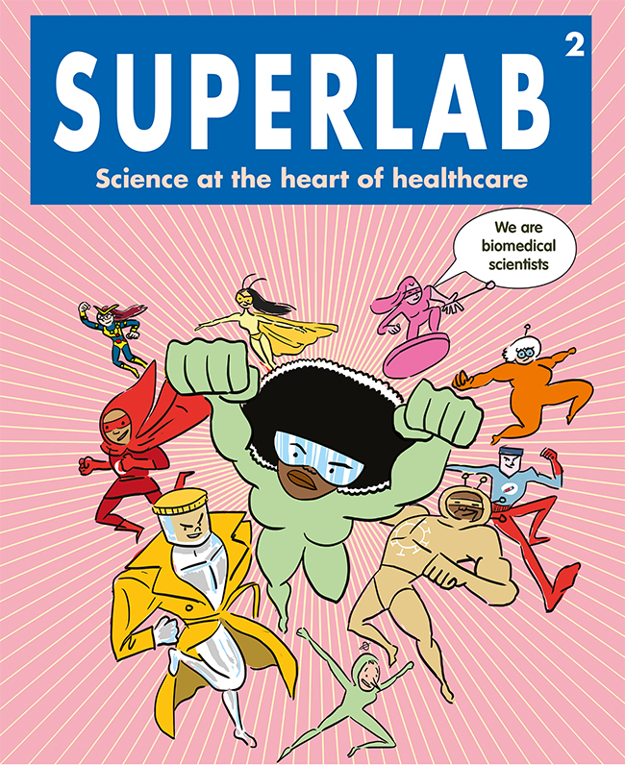
The future Ideas for Harvey’s Gang
Create a Superlab comic for patients and use characters in certificates, stickers and merchandise to promote role of different disciplines.
Encourage information sharing across sites and for more disciplines aside Blood Sciences to get involved.
Create activities for each discipline to provide support and guidance for the tours.
Rebrand to consider new logo (teddy bear) and loss of ‘gang’ from name. Focus shift away from Harvey as the original patient who sadly passed away.
Identify opportunities to take Harvey’s Gang out of the laboratory to increase awareness – i.e. school visits, children’s wards, VR tours.

