Slide 1
Holistic first- hand experience of training within the Metabolic Stakeholders laboratories
Claire L Peat BSc LIBMS
Higher Specialist Biomedical Scientist
Nottinghamshire University Hospitals

Slide 2
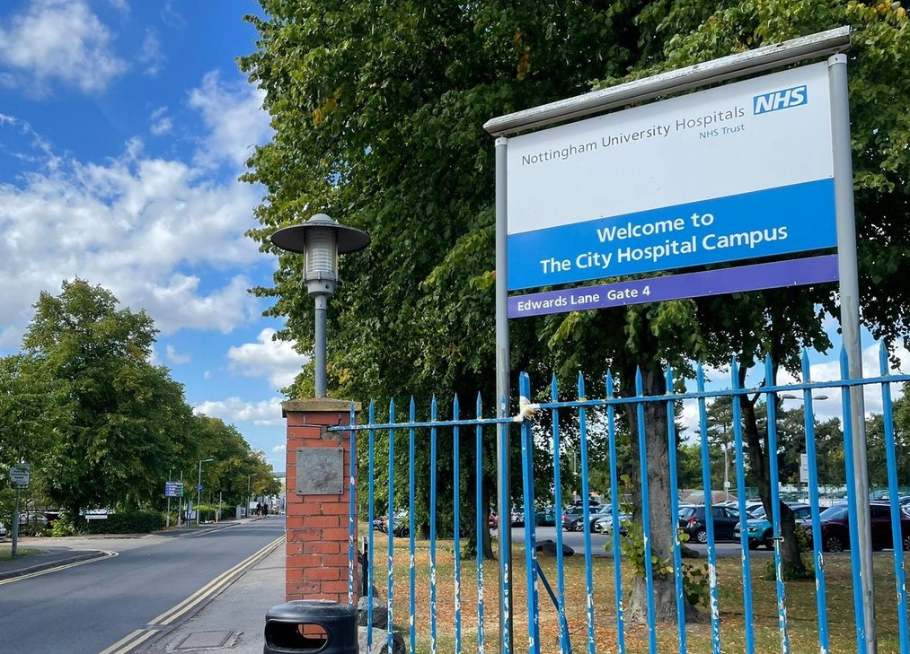
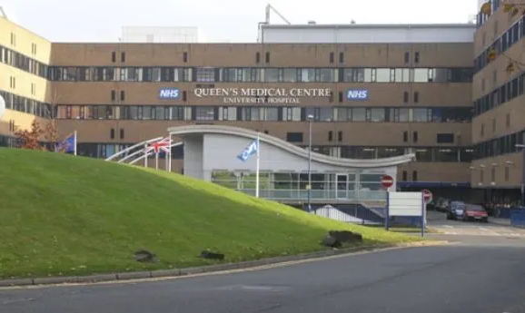
Introduction

Slide 3
Specialist portfolio training
22 sections covering a variety of pathological conditions, quality and analytical techniques.
Completing the evidence pieces, specialist questions and, be able to demonstrate competency in all sections
NUH training opportunities

Slide 4
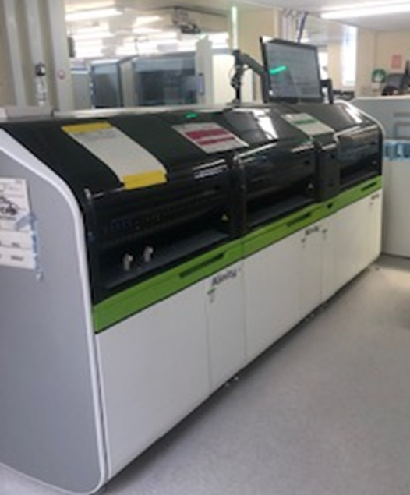
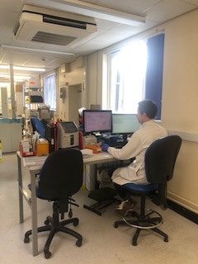
Autocore and Validation
Dedicated validation bench for technical validation of abnormal or out of clinical range results
Both sites have 4 Alinity C units and 4 Alinity I units.
Test capacity for 8 units is 1200 per hour
Osmolality and Direct ISE

Slide 5
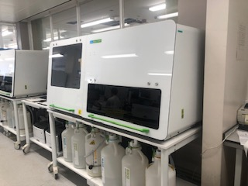
Trisomy
Trisomy section screens for Edwards’ Syndrome, Patau’s Syndrome and Down’s syndrome
Screens can be performed on first trimester and second trimester samples
We use an AutoDELFIA analyser for Trisomy screening
NIPT

Slide 6
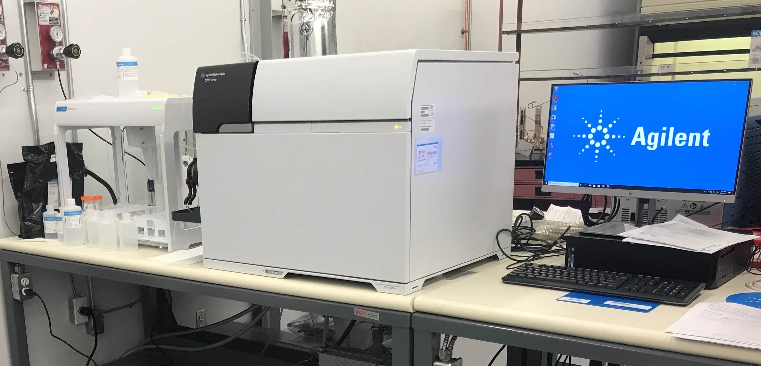
Trace elements
Trace elements laboratory analyses using ICP-MS

Slide 7
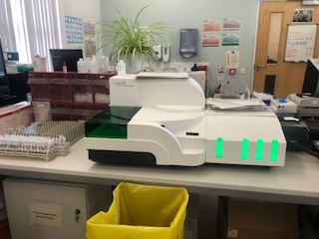
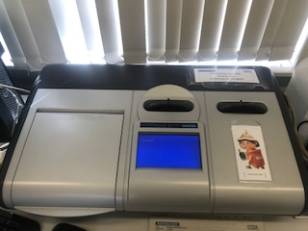
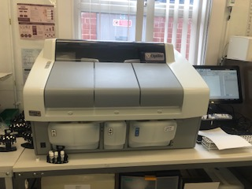
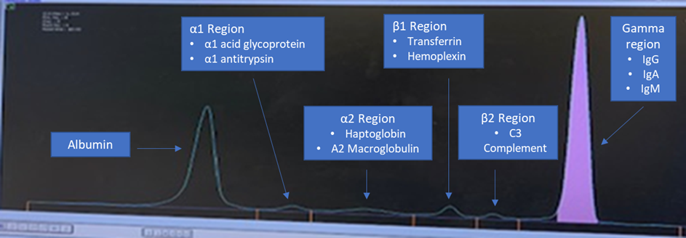
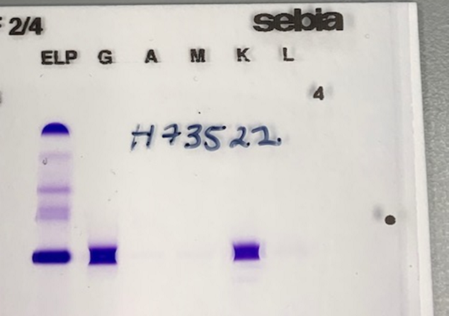
Immunochemistry
Sebia CZE analyser, Sebia Hydrasys and Optilite Serum Free Light Chain analyser
SFLC processed on serum in batches
Free light chains are also detected in urine. This test is Bence Jones proteins
Not specific to Multiple Myeloma
Capillary zone electrophoresis trace showing a
paraprotein band in the Gamma region.
Immunofixation gel

Slide 8
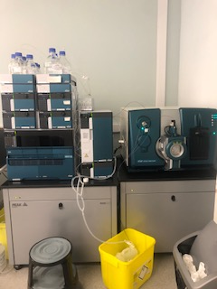
Mass spectrometry
& Immunosuppressant monitoring
Tandem mass spectrometer
Immunosuppressant analysis for tacrolimus, ciclosporin
and sirolimus
Covering therapeutic drug monitoring for
Nottinghamshire, Leicestershire and Lincolnshire
Analytical method LC MS/MS

Slide 9
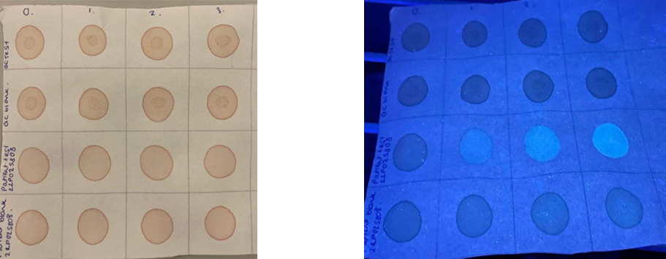
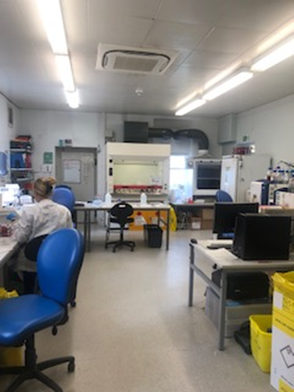
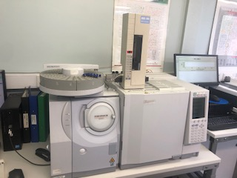
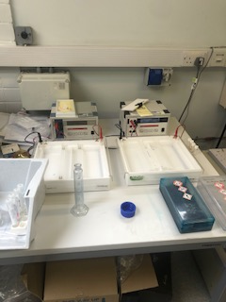
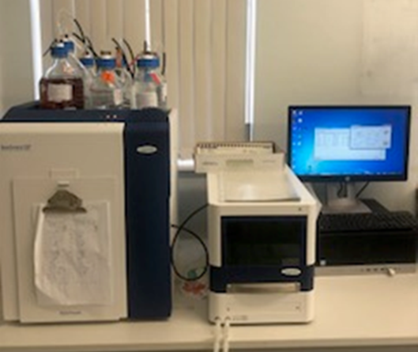
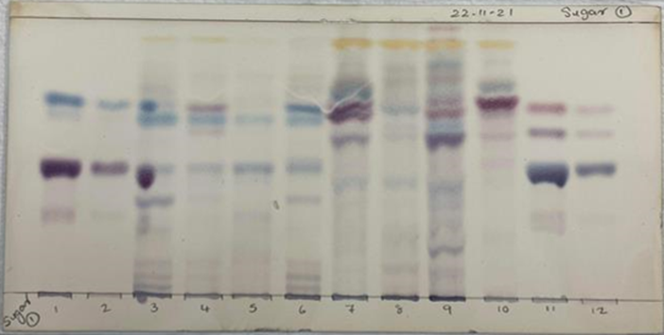
IEM
Main area of work during specialist portfolio completion
What do we do at NUH
My role within this department

Slide 10
Positives and challenges
Extensive knowledge in a specialist area to aid training of others
High quality worked examples in portfolio
In-depth experience to become a specialist biomedical scientist in inborn errors of metabolism
Challenging to show specialist knowledge in other areas not covered in metabolic
Evidence pieces largely theory based
Difficulty showing laboratory competence in other sections due to high demand for metabolic laboratory cover

Slide 11
Portfolio feedback
Largely positive
Reference to experience in specialist techniques
Highlighted weaker points during feedback including questions based around autocore technical validation.

Slide 12
Final thoughts
Proud to be a BMS
Enjoyed developing over the last 15 years
Staff feedback on current portfolio

Slide 13
Any questions?

