Slide 1
Newborn Screening & Biochemical Genetics Transition to ISO15189:2022
Emilie Terry
Quality Lead
Senior Biomedical Scientist
January 2024
Notes:
Hello
Thank you for inviting me to talk today. We only had our transition and surveillance visit last week so this has been put together rather quickly so I hope it makes sense and is useful to you. If I start to speak to fast just let me know.

Slide 2
My role in NSBG
BMS Specialist Cytopathology 2004-2019
Senior Biomedical scientist since 2010
Quality Lead since 2010 CPA > UKAS
IBMS Certificate for expert practice in Quality Management 2010
Quality lead role NSBG July 2019
Notes:
Firstly, I thought I would give a bit of an introduction to myself and how I ended up in quality management. I am a senior biomedical scientist. I first qualified as a specialist Biomedical scientist in Cytopathology for the Cervical Screening programme and since 2010 I have been involved in the quality management side. I came to NSBG in 2019 as quality lead as after several mergers and laboratory closures, I decided to make a change toa role in quality management with no technical responsibility.

Slide 3
OBJECTIVES
Brief introduction to UKAS accreditation
Transition to ISO15189:2022
UKAS Gap analysis requirement
Completion of the action plan
Key changes we identified
Our experience at assessment
Useful resources
Notes:
I am here to talk to you about the new version of ISO15189: released in December 2022. Feedback on the what work I did to prepare for our transition assessment , completing the gap analysis and action plan, the key changes we identified and give you some feedback on our transition experience.

Slide 4
ISO 15189: UKAS ACCREDITATION
ISO 15189:2022 – Medical Laboratories is an international standard that specifies the requirements for quality and competence in medical lab environments. Essentially, it is a standard that requires labs to develop a robust, reliable quality management system (QMS) to establish their competence.
Notes:
To begin with I just wanted to give a reminder on the standards medical laboratories can become accredited to and why. Accreditation to ISO15189 is basically how we can as medical laboratories ensure we have a quality management system in place that is compliant and ensure we provide a service to our users and patients that is risk managed, continually looking for improvements and we can provide assurance to our users that we are competent for the services we provide.

Slide 5
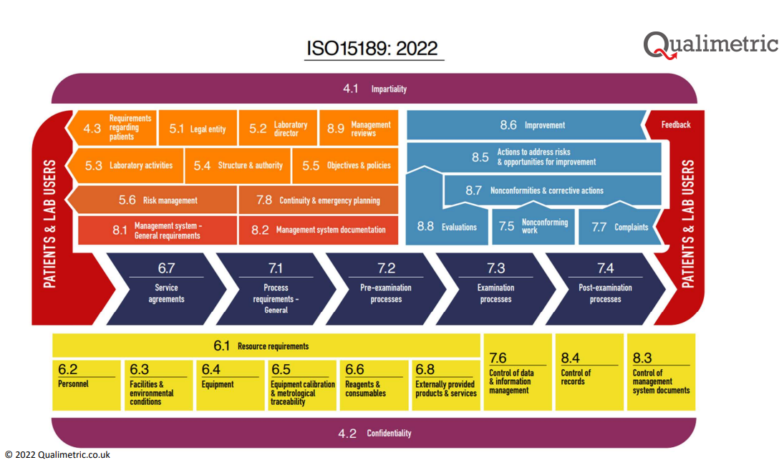
ISO15189:2022
Microsoft PowerPoint - ISO 15189 2022 QM Slide (qualimetric.co.uk)
Notes:
This is a diagram representation of ISO15189:2022 taken from the Qualimetric website that also has a very useful gap analysis document that I have provided a link for at the end.

Slide 6
Why revise the standard?
The three significant changes made to ISO15189 with the 2022 revision:
Alignment with ISO7025:2017 Standard for competence for calibration laboratories.
Incorporation for point of care testing (POCT) into the standard, previously ISO22870
An increased emphases on risk management throughout.
Notes:
When searching what are the key changes between 2012 and 2022 there are three significant changes. The new version was developed for alignment between ISO7025:2017 the UKAS standard for competence for calibration laboratories. As UKAS recognised the involvement that medical labs have in POCT. They have incorporated the requirements for point of care testing into 2022 as this was previously its own stand alone standard and finally the 2022 version emphasises the importance of risk management – something I think majority of accredited laboratories will already have procedures in place for.

Slide 7
Timescale for Transition
2022
December -ISO15189:2022 Published
2023
UKAS Training for assessors & Laboratories start working towards, completing gap analysis and making changes to documentation, audits etc.
2024
Assessment to 2012 with transition to 2022
2025
Transitioned to 2022 as ISO 15189:2012 Medical laboratories – Requirements for quality and competence ceases to be valid as of 06 December 2025.
Notes:
The transition to ISO15189:2022 started with the version being published in December 2022.
2023 was the period of training for both UKAS assessors and those involved in quality management and starting to figure out where the gaps were for us as a laboratory by auditing our QMS and procedures against the standard. I spent 2023 attending UKAS webinars, the IBMS congress talks to gain further understanding and started our gap analysis and action plan for transition across to the 2022 version.
2024, is where we our now – UKAS have started the transition assessments and this occurs alongside your surveillance visit where you have your gap analysis assessed and also see if you still conform to 2012.
2025 everyone who is accredited should have transitioned across to 2022 and 2012 requirements will cease to be valid by December.

Slide 8
What is different?
Change to the numbering and structure
The standard is deliberately less prescriptive and therefore are the 'minimum requirement'
Terminology for conformance:
Shall = Mandatory must do it
Should = Recommendation
May = Permission
Can = Possibility or if have the capability
Notes:
So what is different?
To begin you see the number changes, structural changes and some new clauses that previously were notes or included under clauses with other requirements.
The standards are less prescriptive than 2012. UKAS re-enforced that they are the minimum requirement which I thought was important to understand, as even if it isn't in the standards anymore, it doesn't mean you don't have to do it.
There are changes in the conformance terminology - as UKAS now recognise that each discipline is different and may have different requirements - Shall statements are mandatory, should is recommended – if you aren't going to conform to these you really need to a solid justification for why?,
May is permission – this may be used where things may not apply to every discipline – again you still need to have some justification for not conforming and
Can refers to statements for things that are possible or if you have the capability.

Slide 9
What is different?
Modernisation with how we do things in labs today
  For example, don’t have to have a hard-copy requests/reports as many labs have electronic requesting and reporting.
  Quality Manual – optional non longer a requirement – 8.2.1 Note
  The management system, documents can, but are not required to be contained in a quality manual – we felt it was easier to have a quality manual in that covers the entire standard.
Incorporates other related standards:
-ISO/TS 20914 (2019) Measurement of uncertainty
-ISO 20658 Pre-examination, specimen transport
-ISO 151909 (2019) Requirements for safety
-ISO 22367 Medical Laboratories – Application of risk management to medical laboratories
Notes:
The 2022 version has been modernised for how laboratories operate today.
One example here is that we no longer have to have a hard-copy request or report as many labs now use electronic requesting and reporting.
There are also incorporation of other ISO standards. You won't be assessed against these individually as the requirements are built into ISO15189. I would advise having a look at these if you want further understanding if they apply to you. Buying all the standards is expensive its not compulsory.

Slide 10
My First Impressions
The term "Validity of examination results" – is a key theme throughout – protecting patient safety outcomes.
4.3 Requirements regarding patients
6.2.3 Authorisation
7.5 Nonconforming work
7.8 Continuity and emergency preparedness planning
8.5 Actions to address risk & opportunities for improvement
Notes:
Other changes I picked up on is instead of quality of examination results, the term validity pf examination results is a key theme throughout and protecting patient safety outcomes.
Also what looked like new clauses but were already part of 2012 but now had their own standard alone section because deemed more important in 2022 -
4.3 requirements regarding patients,
6.2.3 Authorisation,
7.5 Nonconforming work,
7.8 Continuity and emergency preparedness planning
8.5 Actions to address risk & opportunities for improvement.
We will go through these in a little more detail later on.

Slide 11
COMPLETING THE UKAS GAP ANALYSIS
Accredited laboratories who are currently accredited to ISO 15189:2012 are required to review the new standard, conduct a gap analysis and establish a transition plan to incorporate the required changes (where applicable) into their management system.
  UKAS Gap analysis template should be provided by your assessment manager with a date for submission (4 weeks before your next surveillance).
Submit the gap analysis along with ALL evidence to support compliance, and your action plan for meeting the standard for example updating documentation with reference to IS15189:2022 or any gaps.
Notes:
The first part of working towards transition to 2022 is the completion of your gap analysis looking at what you have in place for 2012 and if you still meet the requirements for 2022.
All accredited laboratories are required to conduct the gap analysis, and this should be sent to your assessment manager with all the evidence to support your analysis and compliance, 4 weeks before your next visit.

Slide 12
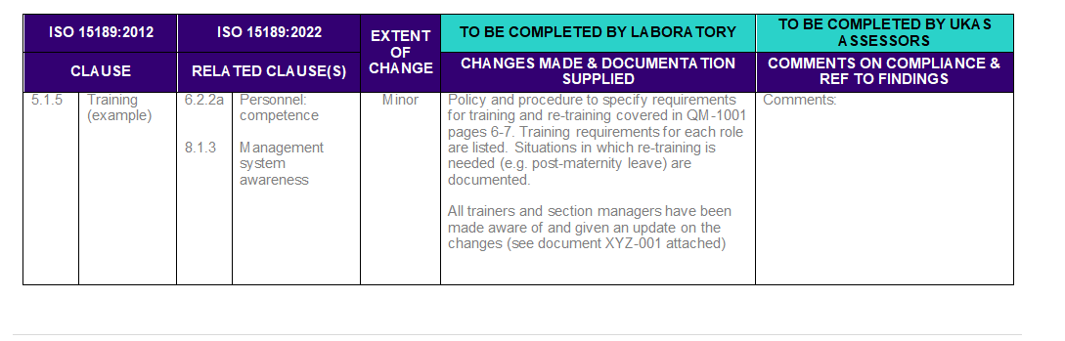
UKAS Gap analysis template
Available from UKAS website: https://www.ukas.com/resources/technical-bulletins/iso-151892022-transition-process-guidance/
Notes:
Here I have provided the link for the gap analysis template from the UKAS website.
I found that UKAS hadn't included everything in this template I made sure I covered everything in the 2012 clause and reference against its corresponding requirement in 2022.
As some things in 2012 no longer a requirement in 2022 I still wanted to demonstrate what we had in place.
The extent of the changes are described as Minor, Major or structural.
When updating your documentation or procedures make sure you start where you identify the major changes to address the risks for your service and accreditation.

Slide 13
Gap Analysis Advice
Be careful when reading the standard as where something is not relevant you will need to justify why - suggest you include this justification in your quality manual (& gap analysis)
Every lab will have slightly different approach to meeting the management system requirements and have their own patient/clinical risks according to the services they provide
Be sure to have risk assessed your service process risk assessment
Notes:
Read the standard very carefully and remember is it is a minimum requirement.
If something is not relevant to your service, you will need to justify why you are not going to comply.
I recommend you have evidence of a good process risk assessment for your service that covers the entire standard and evidences what you have in place to mitigate risk and actions that may be required.
We have a process risk that covers our whole sample pathway and the standard so we can evidence to UKAS where we know we have risks, if we can do anything to reduce them what we can action and if the risk is just a tolerated risk what we can do to manage that risk.

Slide 14
Gap Analysis
A good gap analysis is essential so start early and make sure you submit all the supporting documentation to close the gaps and implementation is critical.
Evidence where ongoing work is required in your action plan if not quite completed.
Notes:
The gap analysis will be individual to you as each lab has their procedures, processes in place and risks to address.
It is essential to start your gap analysis and action plan early to give you time to work on updating the documentation and addressing the key clinical and patient risks you have.
Where you aren’t quite there in time for the assessment you will need to provide an action plan.

Slide 15
Creating your action plan
Concentrate on your risks and getting key documentation updated where you know you have gaps
Look at your service and where the potential risks to patients and evidence with your gap analysis of this risk assessment.
Action plan everything else you need to do where you have not submitted evidence - with target dates for completion
  Try to ensure these actions are not overdue at your assessment. If they are you may need to justify why?
Suggest adding these on Qpulse/ipassport so you can demonstrate assigned owners and target dates
Notes:
The first part is to complete your gap analysis in conjunction with your action plan based on your risks and gaps in compliance.
I concentrated on updating each management procedure where I knew we needed to tweak wording or terminology or where I felt we had gaps.
Whilst there is no requirement for a quality manual anymore, you still need a document to demonstrate what documentation or approaches you have in place for conformance with the standard.
I re-wrote our quality manual
Where documentation was compliant and just needed a revision to include some minor changes or just state 2022 instead of 2012, I added these as my action plan to complete across 2024 before our next assessment.
I added all our actions onto Qpulse to assign ownership and target dates for completion so that we could monitor these for completion on Qpulse.

Slide 16
Sending your evidence
Submit using the UKAS SharePoint
Add evidence into folders that cross reference to the gap analysis
In your gap analysis when referencing documentation also include reference to page numbers to highlight where changes or evidence that support compliance.
Notes:
Once our gap analysis was complete and any remaining actions defined as part of our action plan.
The next step was to add the gap analysis to SharePoint.
For each clause I added the documentation to support compliance.
I created folders with clear descriptions and added as much evidence as possible including any horizontal audits we had completed that showed we complied with 2022.
I also ensured I referenced page numbers where I had updated key information for any changes in documentation provided.
I received good feedback on this approach from the assessor. This made our assessment go very quickly as the assessment was only on our gaps or where questions were raised to look at little more.

Slide 17
4.3 Requirements regarding patients
The revised ISO 15189:2022 contains enhanced requirements for medical laboratories to plan and implement actions to address risks, especially risks to the patients, and opportunities for improvement. In response, laboratories must implement a quality management system which supports a risk-based approach.
  Patient focused – all about patient care and clinical risks based on your service and your users, geographical location, staff, organisation etc.
  Align your objectives to clinical/patient risks or needs
  Risk to patient is considered in your investigations
  Implement mechanisms for patient feedback.
  Quality policy updated with treatment of patients and samples with care respect.
Notes:
As I have already said 2022 is all about patient care and clinical risks based on your service and your users, geographical location, staff, organisation etc.
Ensure you align your objectives to clinical/patient risks or needs
That the impact and Risk to patient is considered in your investigations for incidents, CAPAs etc
Implement mechanisms for patient information and feedback.
Treat patients and samples with care and respect, free from discrimination
we updated our Quality with emphasise on the patient.

Slide 18
6.2.3 Authorisation
The laboratory shall authorize personnel to perform specific laboratory activities, including but not limited to:
selection, development, modification, validation, verification of examination methods.
Review, release and reporting of results
Use of LIMS- accessing & entering patient data and information, changing data and results
Notes:
Authorisation clause in my opinion is closely linked with competency but essentially 6.2.3 is looking at have you defined who is authorized to complete specific roles and processes -
those listed include –
selection, development and modification, validation and verification of methods,
The review release and reporting of results,
use of laboratory information systems to access patient data, entering patient data and examination results and changes to patient data and results.
We have these defined in each procedure, job descriptions, LIMS user access with access control limits dependent on role and supported each of these with training and competency evidence.

Slide 19
7.5 Nonconforming work clause
The laboratory shall have a process for when any aspect of its lab activities or examination results do not conform to its own procedures, quality specifications or user requirements.
7.5 a-g covers all action take to investigate, determine risk impact and extent and implement actions and corrective actions, notifying users and responsibility for authorizing the resumption of work etc.
Notes:
Nonconforming work clause which relates to process for when laboratory activities or examination results do not conform to its own procedures.
We ensure that someone takes responsibility for implementing immediate and long term actions,
if risk to patients we halt examinations to investigate and we look at clinical significance of the nonconforming work for the current affected result and previous.
This was already sort of part of 5.6 ensuring quality of examinations and the non-conformity clause in 2012 that looks at when we have poor performance, assess risk, impact and extent but now has its own stand alone standard.

Slide 20
7.8 Continuity and emergency preparedness planning
BCP plans for LIMS and service (equipment back up, reagents)
Now standalone clause
Evidence of periodic testing
What plans you have in place
Are these shared with ALL your team.
Are staff trained and competent to understand and implement the plans
Demonstrate periodic testing- included in our audit schedule (tabletop exercise).
Notes:
Business contingency planning was already in 2012 was incorporated into management requirements but only really stated that we would have plans in place, back ups etc .
Now has its own standalone clause, to ensure that not only have you defined your BCP plans,
that you have covered all risks not just LIMS downtime,
Are your plans are shared with the wider team?
and do you have evidence of training and competency for those responsible for understanding and implementing the business continuity plans.
Do you have evidence of periodic testing and review of your plans for example performing a tabletop exercise or testing a downtime scenarios.

Slide 21
8.5 Identification of risks and opportunities for improvement
This was covered in 2012 by preventive actions or quality improvements
Already do this- How we look at our performance as part of outcome of management review, internal audit findings user feedback, staff suggestions etc.
If we see risk what are we doing to address it – Process risk for whole service to determine risks and actions
Notes:
This came under preventive actions in 2012 but now incorporates risk management. Looking at your service and continual improvement if you see trends or risk in performance what can you do to address that risk and opportunities for improvement. For example acting on user feedback, audit findings, outcome of management reviews etc. If you see a potential for risk implement something to prevent it occurring or improve a performance trend.

Slide 22
7.3 Validation Verification of Examination Methods
Who is authorised to complete this work and give the approval to implement new methods? (6.2.3 a)
Periodic Review of:
  Biological reference intervals and critical decision limits (7.3.5)
  Evaluate examination methods ensure clinically appropriate– is there any new test/method that is better? Is the testing still relevant? (7.3.1 e)
  Review of Measurement of Uncertainty (7.3.4)
  We evidenced review of all our validation/verification work every two years or sooner if there are any changes.
  Informing our users of changes when
  necessary.
Notes:
Validation and Verification is already covered in 2012 but in a little more detail for 2022 and was a focus at some of the UKAS training I attended and was looked at the assessment visit
- focusing on the is requirement to evidence that those completing and authorising validation or verification of your examination methods is authorised to do so – this links in with 6.2.3 Authorisation clause.
We must ensure periodic review of clinical justification of examination methods are we using them for their intended use have we validated this?,
If there are changes or modifications have, we got evidence of re-verification.
Ensure there is periodic review of biological reference intervals and critical decision limits and measurement of uncertainty.
Also ensuring inform users of changes where necessary.

Slide 23
Our transition assessment experience
Review of the Gap Analysis, plan and related documentation
- On-site assessment (conducted at time of an organisation’s annual surveillance or reassessment).
Surface look at procedures/processes in place, looking a examples to support that process in place
Next assessment will be a deeper dive
Provide evidence where questions raised
We received 2 findings and 1 recommendation.
Notes:
The experience of the transition assessment was so much easier than what I had built up in my head.
I kept wondering if I had missed something as we were already complying with most areas and could not see any huge differences, despite the major new changes.
The transition assessment was as UKAS say a sampling exercise, was a skim across the surface look as they have to look at everything and because we had a detailed gap analysis with a lot of evidence this meant they only needed to look at the very new clauses in more detail.
We ran through procedures with a sampling exercise of a piece of evidence to show it was embedded or they identified the action we had in place and looked if we were on target to meet that.
Some actions I had stated would be completed by January 2024, our assessment was on 25th January so I argued it was still January.
We were advised that the next assessment would be a deeper dive.
We had a very good assessment with 2 minor mandatory findings and 1 recommendation with no findings towards 2012.

Slide 24
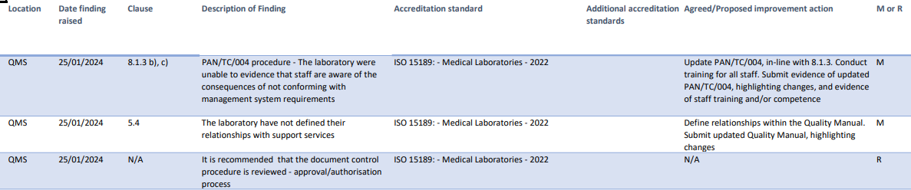
Findings
IAR for transition 4 weeks to close with evidence.
8.1.3 b) c) Personnel understanding consequence for not conforming to standard.
2) 5.4 Internal support services – who are they and what relationships and route for escalation we have – we need to update our quality manual.
3) Management of documents and authorisation
– who is an approver, how we select and evidence this is happening
Notes:
Not sure if you can read this but I am happy to share this with you so that you can have a look closer.
Our findings were very similar to other labs in our trust and other trusts as assessment managers are focusing on the key new clauses in 2022. We received no findings to 2012 part of the surveillance visit.
1 finding was regarding demonstrating our staff understand the consequences of not conforming to the standard, we already do impact assessment of nonconformances to the patient, staff, visitors and our service but we had not included this in our quality management competency.
Our second finding related to the not defining relationships with internal support services for example Estates, HR, finances, something we had sort of detailed to some extent in our quality manual but not defined the relationships and route for escalation.
The recommendation for to update our document management procedure more clearly on who we authorise to approve documentation – we stated we select those technically or clinically competent but we had not audited this previously or included selecting the approve in our competency.
We were happy these were only minor we were almost there just some tweaks to our documentation, audit and training and competency.

Slide 25
Information resources
UKAS accreditation information
UKAS - The UK Accreditation Body - Creating Confidence
Publications – UKAS
Information on Transition: ISO 15189:2022 transition arrangements (ukas.com)
ISO15189:2022 available to buy:
BS EN ISO 15189:2022+A11:2023 | 31 Dec 2023 | BSI Knowledge (bsigroup.com)
Qualimetric Ltd conducted an analysis of the key changes and additional requirements of the new standard against the 2012 edition. This is available to download free of charge from our website.
Click on this link to download: Microsoft Word - ISO 15189 comparison 2012 and 2022 Summary 0123 (qualimetric.co.uk)
Notes:
Hopefully today has given you some useful advice to help with your laboratory transition or understanding the key changes in ISO15189:2022. Here are some useful links to help with purchase of the new standard, UKAS website and the gap analysis I mentioned complete dby Qualimetric Ltd.

Slide 26
THANK YOU!
Any questions?

